Slide 1
CS630 AI Agent Engineering Module 01 Basic AI Agent
Agent
AI Agent
Google Agent Development Kit (ADK)
Environment Setup and Running it
Notes:
In this module 01, we will study the concepts of a basic AI agent.

Slide 2
Agent
An agent is an entity that perceives its environment through sensors and acts upon that environment through actuators to achieve specific goals.
Everyday Examples:
A human (sees, hears, moves, decides)
A robot vacuum (senses dirt, navigates rooms, cleans)
A thermostat (measures temperature, turns heating/cooling on or off)

Slide 3
AI Agent
an AI agent doesn't "perceive" in the human sense, but in AI, perception is often defined more abstractly.
Perception = receiving data from the environment
via sensors, inputs, APIs, or system signals.
So even though an AI agent:
Doesn’t “see” or “hear” like a person,
It still receives inputs — text, sensor data, camera feeds, or user prompts.

Slide 4
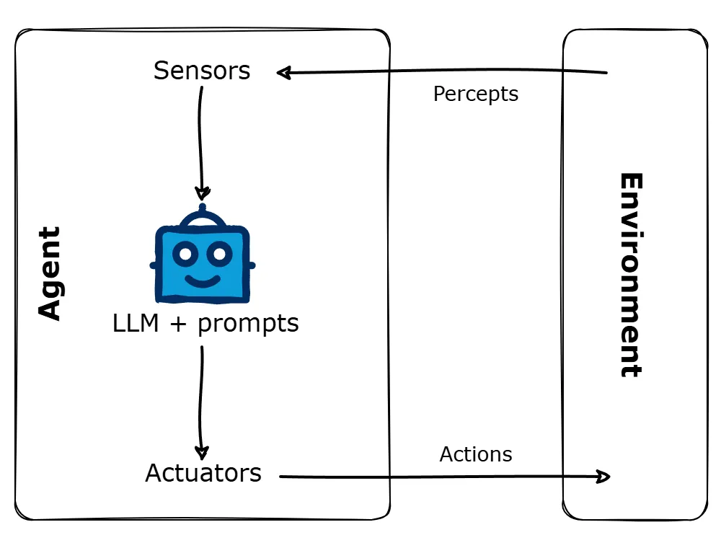
Agent
(Russell & Norvig, 2022)

Slide 5
Examples of AI Agent Perception
Agent Type | “Perception” Means…
Chatbot | Receiving user text input
Self-driving car | Camera, radar, LiDAR data
Stock-trading bot | Real-time market data feeds
Email spam filter | Scanning message content & metadata

Slide 6
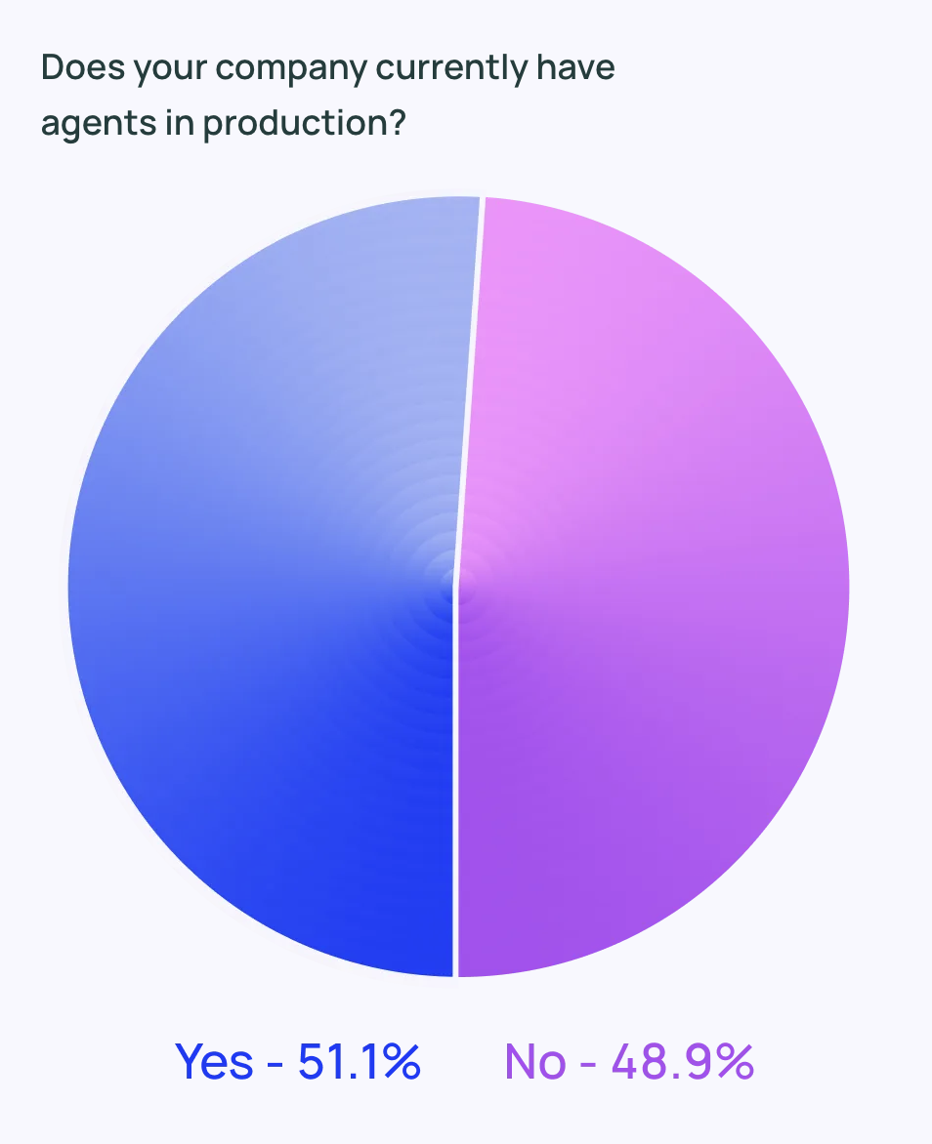
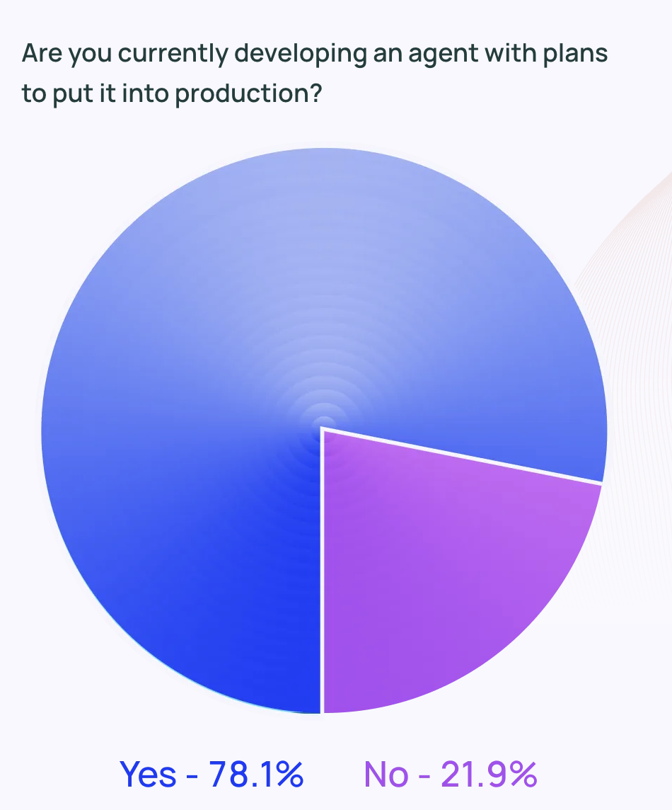
Surveyed over 1,300 professionals
(LangChain, 2024)

Slide 7
Standard Agent Architecture
Perceive → Decide → Act
Even symbolic/logical agents or LLM-based agents follow this pattern with abstract forms of input/output.

Slide 8
How Do AI Agents Work?
Software AI agents operate through a combination of perception, reasoning and action.
At their core, they use Large Language Models (LLMs) to understand inputs and make decisions.
(Dmitrievna‌ & Parsadanyan, 2025)
Notes:
Input processing
The agent receives information through various channels - direct user questions, system events, or data from external sources. We’ll explore different input types when discussing agent sensors later in this article.
Decision-making
Unlike simple chatbots, AI agents use multi-step prompting techniques to make decisions. Through chains of specialized prompts (reasoning, tool selection), agents can handle complex scenarios that are not possible with single-shot responses. We’ll examine this “reasoning engine” in detail in the components section [anchor link to the relevant section].
Action execution
Modern LLMs generate structured outputs that serve as function calls to external systems. For a detailed look at how agents interact with external services and handle feedback loops, check our guide on building AI agentic workflows.
Learning and adaptation
Some agents can improve over time through various mechanisms - from simple feedback loops to sophisticated model updates. We’ll explore these learning approaches in detail in the FAQ section.
The exact implementation of these components depends on the purpose and complexity of the agent, as you’ll see in our examples of both human-activated and event-activated agents.

Slide 9
How Do AI Agents Work?
Real power comes from the interaction of these elements
Input processing: direct user questions, system events, or data from external sources
Decision-making: use multi-step prompting techniques to make decisions
Action execution: Modern LLMs generate structured outputs that serve as function calls to external systems
Learning and adaptation: from simple feedback loops to sophisticated model updates
(Dmitrievna‌ & Parsadanyan, 2025)
Notes:
Input processing
The agent receives information through various channels - direct user questions, system events, or data from external sources. We’ll explore different input types when discussing agent sensors later in this article.
Decision-making
Unlike simple chatbots, AI agents use multi-step prompting techniques to make decisions. Through chains of specialized prompts (reasoning, tool selection), agents can handle complex scenarios that are not possible with single-shot responses. We’ll examine this “reasoning engine” in detail in the components section [anchor link to the relevant section].
Action execution
Modern LLMs generate structured outputs that serve as function calls to external systems. For a detailed look at how agents interact with external services and handle feedback loops, check our guide on building AI agentic workflows.
Learning and adaptation
Some agents can improve over time through various mechanisms - from simple feedback loops to sophisticated model updates. We’ll explore these learning approaches in detail in the FAQ section.
The exact implementation of these components depends on the purpose and complexity of the agent, as you’ll see in our examples of both human-activated and event-activated agents.

Slide 10
Types of Agents
Simple reflex agents
Model-based reflex agents
Goal-based agents
Utility-based agents
Learning agents
(Russell & Norvig, 2022)
Notes:
Simple reflex agents
These agents are fairly straightforward - they make decisions based only on what they perceive at the moment, without considering the past. They do their job when the right decision can be made just by looking at the current situation.
Model-based reflex agents
Model-based reflex agents are a little more sophisticated. They keep track of what's happening behind the scenes, even if they can't observe it directly. They use a "transition model" to update their understanding of the world based on what they've seen before, and a "sensor model" to translate that understanding into what's actually happening around them.
Goal-based agents
Goal-based agents are all about achieving a specific goal. They think ahead and plan a sequence of actions to reach their desired outcome. It's if they have a map and are trying to find the best route to their destination.
Utility-based agents
These ones are even more advanced. They assign a "goodness" score to each possible state based on a utility function. They not only focus on a single goal but also take into account factors like uncertainty, conflicting goals and the relative importance of each goal. They choose actions that maximize their expected utility, much like a superhero trying to save the day while minimizing collateral damage.
Learning agents
Learning agents are the ultimate adaptors. They start with a basic set of knowledge and skills, but constantly improve based on their experiences. They have a learning element that receives feedback from a critic who tells them how well they're doing. The learning element then tweaks the agent's performance to do better next time. It's like having a built-in coach that helps the agent perform their task better and better over time.

Slide 11
Benefits of AI Agents
Faster information analysis and decision-making
Increased team productivity
Enhanced customer experience
Accelerated software development
Improved data quality and consistency
(Dmitrievna‌ & Parsadanyan, 2025)
Notes:
Faster information analysis and decision-making
Handle large amounts of data, extract key insights and create summaries. This frees professionals from time-consuming research tasks and helps teams make data-driven decisions faster.
Increased team productivity
Automate routine tasks, manage schedules and optimise workflows. Teams report that they have more time for creative and strategic work when agents are busy with administrative tasks.
Enhanced customer experience
Speed up response times, handle basic inquiries and 24/7 support. This improves customer satisfaction and reduces the burden on support teams.
Accelerated software development
Help with coding tasks, debugging and documentation. This speeds up development cycles and helps maintain code quality.
Improved data quality and consistency
Automatically process and enrich data, ensure consistency and reduce manual data entry errors.

Slide 12
AI Agent or LLM Agent
Large Language Model as the brain
Reasoning and Planning
Memory
Tools
Autonomous operation
(Dmitrievna‌ & Parsadanyan, 2025)
Notes:
Large Language Model (LLM) as the Brain: At its heart, an LLM agent uses a powerful LLM (like Gemini, GPT-4, etc.) to understand human language, reason through problems, generate responses, and make decisions. The LLM processes the user's input and internal thoughts, acting as the central coordinator.
Reasoning and Planning: Unlike a basic LLM, an agent can often:-
Reason: Think through a problem, break it down into smaller steps, and draw logical conclusions. This often involves techniques like "chain-of-thought" prompting.
Plan: Formulate a sequence of actions needed to achieve a specific goal, even for multi-step tasks.
Memory: LLM agents incorporate memory to maintain context and learn over time:
Short-term memory: This allows the agent to remember the immediate conversation history and current context within a single interaction. It's like a notepad for the ongoing task.
Long-term memory: This enables the agent to recall information from past interactions, learn from previous experiences, and adapt its behavior to user preferences or common patterns. This often involves storing information in vector databases and retrieving relevant snippets.
Tools and Interaction with the Environment: A crucial aspect of LLM agents is their ability to use external “tools.” These tools extend the agent's capabilities beyond its inherent language generation:
Information Retrieval: Accessing databases, knowledge bases, or the internet (via search APIs) to gather specific, up-to-date information.
Calculations/Logic: Using code interpreters, mathematical engines, or other APIs to perform computations or execute specific logic.

Slide 13
Google Agent Development Kit (ADK)
Empowers developers to build sophisticated, modular, and production-ready AI agents, from simple task executors to complex multi-agent systems
Notes:
The Google Agent Development Kit (ADK) is an open-source, code-first framework designed to simplify the process of building, evaluating, and deploying sophisticated AI agents, particularly those powered by large language models (LLMs). In essence, the Google ADK empowers developers to build sophisticated, modular, and production-ready AI agents, from simple task executors to complex multi-agent systems, with a focus on flexibility, control, and seamless integration within the Google Cloud ecosystem.
1. Purpose and Core Philosophy:
Simplifying Agent Development: ADK aims to make building complex AI agents more akin to traditional software development, focusing on code-first definitions, modularity, and testability.
Controllable Agent Behavior: It provides developers with precise control over agent behavior and orchestration, which is crucial for building reliable and predictable AI applications.
Multi-Agent Systems: A core strength of ADK is its design for building and managing multi-agent systems, where specialized agents can collaborate, delegate tasks, and operate in a hierarchical structure to solve complex problems.
2. Key Features and Capabilities:
Code-First Development (Python & Java): Developers define agent logic, tools, and orchestration directly in Python (and recently Java), offering maximum flexibility and integration with existing software development practices.
Rich Tool Ecosystem:
Agents can be equipped with a diverse set of "tools" to interact with the outside world, such as pre-built Google tools (like Google Search, BigQuery), custom Python functions, OpenAPI specifications, and integration with third-party libraries (e.g., LangChain, CrewAI).
A significant part of this is the Model Context Protocol (MCP) Toolbox, which standardizes how agents connect to various data sources, including databases.
Flexible Agent Orchestration:
LLM Agents (LlmAgent): Utilize LLMs for natural language understanding, reasoning, planning, and dynamic decision-making.
Workflow Agents (SequentialAgent, ParallelAgent, LoopAgent): Define predictable execution flows for other agents (e.g., run agents in a sequence, in parallel, or in a loop) without relying on an LLM for flow control.
Custom Agents: Allow for highly tailored operational logic and integrations by extending the base agent class.
Integrated Developer Experience:
Local Testing & Debugging: Provides a powerful Command Line Interface (CLI) and a visual Web UI for developing, testing, and debugging agents locally. You can inspect events, state, and agent execution step-by-step.
Built-in Evaluation: Offers a framework to systematically assess agent performance against predefined test cases, evaluating both the final response quality and the execution trajectory.
Deployment Options:
Agents built with ADK can be easily containerized and deployed.
Optimized for seamless deployment on Google Cloud platforms like Cloud Run or scaled using Vertex AI Agent Engine, a fully managed runtime for production AI agents with built-in features for context management, infrastructure, scaling, security, and monitoring.
Bidirectional Streaming: Supports unique bidirectional audio and video streaming capabilities for human-like and interactive conversations, moving beyond just text-based interactions.17
Model Agnostic (with Google Optimization): While optimized for Gemini and the Google Cloud ecosystem (Vertex AI), ADK is designed to be model-agnostic, meaning it can work with various LLMs accessible via Model Garden or LiteLLM.
Agent-to-Agent (A2A) Protocol: Enhancements in communication protocols allow agents to collaborate effectively and securely, supporting stateless interactions and clear authentication requirements.
3. Relationship with Other Google AI Offerings:
Vertex AI Agent Engine: ADK provides the framework for building agents, and Agent Engine is the fully managed platform for deploying, managing, and scaling those agents in production.20 They work in tandem for a complete develop-to-deploy experience.
Gemini Models: ADK is optimized for integration with Google's Gemini models, leveraging their advanced reasoning and tool-use capabilities.21
Model Context Protocol (MCP): ADK supports MCP, which enables agents to connect to diverse data sources and capabilities by leveraging an ecosystem of MCP-compatible tools (including databases).

Slide 14
ADK Purpose and Core Philosophy
Simplifying Agent Development: akin to traditional software development
Controllable Agent Behavior: developers have control over agent behavior
Mult-Agent Systems: specialized agents can collaborate, delegate taks, and operate in a hierarchal structure to solve complex problems
Notes:
The Google Agent Development Kit (ADK) is an open-source, code-first framework designed to simplify the process of building, evaluating, and deploying sophisticated AI agents, particularly those powered by large language models (LLMs). In essence, the Google ADK empowers developers to build sophisticated, modular, and production-ready AI agents, from simple task executors to complex multi-agent systems, with a focus on flexibility, control, and seamless integration within the Google Cloud ecosystem.
1. Purpose and Core Philosophy:
Simplifying Agent Development: ADK aims to make building complex AI agents more akin to traditional software development, focusing on code-first definitions, modularity, and testability.
Controllable Agent Behavior: It provides developers with precise control over agent behavior and orchestration, which is crucial for building reliable and predictable AI applications.
Multi-Agent Systems: A core strength of ADK is its design for building and managing multi-agent systems, where specialized agents can collaborate, delegate tasks, and operate in a hierarchical structure to solve complex problems.
2. Key Features and Capabilities:
Code-First Development (Python & Java): Developers define agent logic, tools, and orchestration directly in Python (and recently Java), offering maximum flexibility and integration with existing software development practices.
Rich Tool Ecosystem:
Agents can be equipped with a diverse set of "tools" to interact with the outside world, such as pre-built Google tools (like Google Search, BigQuery), custom Python functions, OpenAPI specifications, and integration with third-party libraries (e.g., LangChain, CrewAI).
A significant part of this is the Model Context Protocol (MCP) Toolbox, which standardizes how agents connect to various data sources, including databases.
Flexible Agent Orchestration:
LLM Agents (LlmAgent): Utilize LLMs for natural language understanding, reasoning, planning, and dynamic decision-making.
Workflow Agents (SequentialAgent, ParallelAgent, LoopAgent): Define predictable execution flows for other agents (e.g., run agents in a sequence, in parallel, or in a loop) without relying on an LLM for flow control.
Custom Agents: Allow for highly tailored operational logic and integrations by extending the base agent class.
Integrated Developer Experience:
Local Testing & Debugging: Provides a powerful Command Line Interface (CLI) and a visual Web UI for developing, testing, and debugging agents locally. You can inspect events, state, and agent execution step-by-step.
Built-in Evaluation: Offers a framework to systematically assess agent performance against predefined test cases, evaluating both the final response quality and the execution trajectory.
Deployment Options:
Agents built with ADK can be easily containerized and deployed.
Optimized for seamless deployment on Google Cloud platforms like Cloud Run or scaled using Vertex AI Agent Engine, a fully managed runtime for production AI agents with built-in features for context management, infrastructure, scaling, security, and monitoring.
Bidirectional Streaming: Supports unique bidirectional audio and video streaming capabilities for human-like and interactive conversations, moving beyond just text-based interactions.17
Model Agnostic (with Google Optimization): While optimized for Gemini and the Google Cloud ecosystem (Vertex AI), ADK is designed to be model-agnostic, meaning it can work with various LLMs accessible via Model Garden or LiteLLM.
Agent-to-Agent (A2A) Protocol: Enhancements in communication protocols allow agents to collaborate effectively and securely, supporting stateless interactions and clear authentication requirements.
3. Relationship with Other Google AI Offerings:
Vertex AI Agent Engine: ADK provides the framework for building agents, and Agent Engine is the fully managed platform for deploying, managing, and scaling those agents in production.20 They work in tandem for a complete develop-to-deploy experience.
Gemini Models: ADK is optimized for integration with Google's Gemini models, leveraging their advanced reasoning and tool-use capabilities.21
Model Context Protocol (MCP): ADK supports MCP, which enables agents to connect to diverse data sources and capabilities by leveraging an ecosystem of MCP-compatible tools (including databases).

Slide 15
ADK Key Features and Capabilities
Code-First Development (Python & Java)
Rich Tool Ecosystem (Google. Search, LangChain)
Flexible Agent Orchestration (LLM, Workflow, Custom)
Integrated Developer Experience (CLI, Web UI)
Deployment Options (Containerized, Google Cloud)
Bidirectional Streaming (audio and video capabilities)
Model Agnostic (via Model Garden or LiteLLM)
Agent-to-Agent (A2A) Protocol
Notes:
Key Features and Capabilities:
Code-First Development (Python & Java): Developers define agent logic, tools, and orchestration directly in Python (and recently Java), offering maximum flexibility and integration with existing software development practices.
Rich Tool Ecosystem:
Agents can be equipped with a diverse set of "tools" to interact with the outside world, such as pre-built Google tools (like Google Search, BigQuery), custom Python functions, OpenAPI specifications, and integration with third-party libraries (e.g., LangChain, CrewAI).
A significant part of this is the Model Context Protocol (MCP) Toolbox, which standardizes how agents connect to various data sources, including databases.
Flexible Agent Orchestration:
LLM Agents (LlmAgent): Utilize LLMs for natural language understanding, reasoning, planning, and dynamic decision-making.
Workflow Agents (SequentialAgent, ParallelAgent, LoopAgent): Define predictable execution flows for other agents (e.g., run agents in a sequence, in parallel, or in a loop) without relying on an LLM for flow control.
Custom Agents: Allow for highly tailored operational logic and integrations by extending the base agent class.
Integrated Developer Experience:
Local Testing & Debugging: Provides a powerful Command Line Interface (CLI) and a visual Web UI for developing, testing, and debugging agents locally. You can inspect events, state, and agent execution step-by-step.
Built-in Evaluation: Offers a framework to systematically assess agent performance against predefined test cases, evaluating both the final response quality and the execution trajectory.
Deployment Options:
Agents built with ADK can be easily containerized and deployed.
Optimized for seamless deployment on Google Cloud platforms like Cloud Run or scaled using Vertex AI Agent Engine, a fully managed runtime for production AI agents with built-in features for context management, infrastructure, scaling, security, and monitoring.
Bidirectional Streaming: Supports unique bidirectional audio and video streaming capabilities for human-like and interactive conversations, moving beyond just text-based interactions.17
Model Agnostic (with Google Optimization): While optimized for Gemini and the Google Cloud ecosystem (Vertex AI), ADK is designed to be model-agnostic, meaning it can work with various LLMs accessible via Model Garden or LiteLLM.
Agent-to-Agent (A2A) Protocol: Enhancements in communication protocols allow agents to collaborate effectively and securely, supporting stateless interactions and clear authentication requirements.

Slide 16
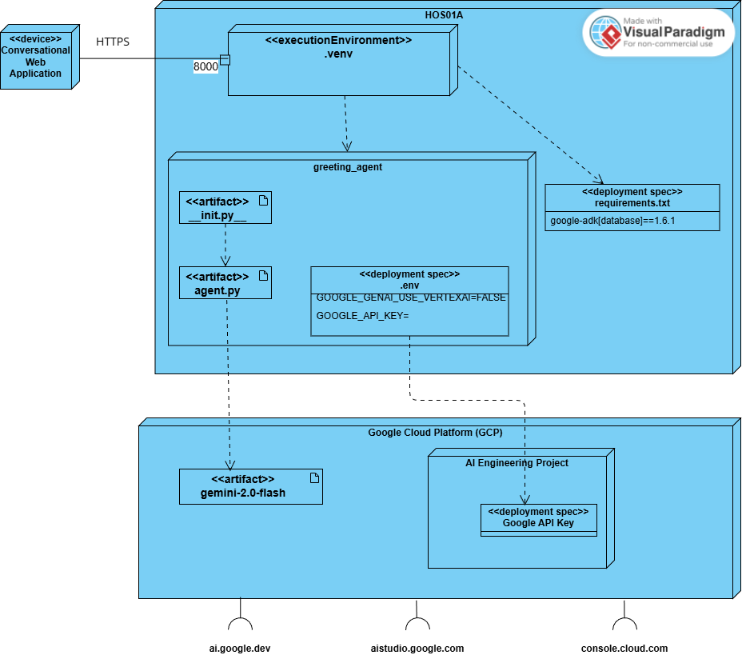
UML Deployment Diagram for Basic Agent
Notes:
Flow of Interaction and Execution:
A Web Application sends an HTTPS request to port 8000 on the HOS01A server.
The HOS01A server's environment (specifically the .venv) receives this request.
The greeting_agent's init.py and agent.py scripts are executed within the .venv.
The agent.py script, leveraging the google-adk library and using the GOOGLE_API_KEY environment variable for authentication, makes API calls to interact with the gemini-2.0-flash LLM.
The gemini-2.0-flash LLM processes the prompts from the agent (this processing happens within Google's cloud infrastructure, managed by services like Vertex AI, even though GOOGLE_GENAI_USE_VERTEXAI=FALSE implies direct Gemini API access rather than Vertex AI's specific managed endpoints).
The LLM returns responses to agent.py.
The agent.py processes the LLM's response and likely sends a greeting or other appropriate output back to the Web Application.

Slide 17
Environment Setup and Running It
Accessing GitHub Codespaces
Installing Python Extension
Creating .gitignore
Setting up our virtual environment
Activating our virtual environment
Installing dependencies
Creating the Agent project structure
Writing the code/logic
Setting up an External Service: API Keys
Running your Agent with adk web

Slide 18
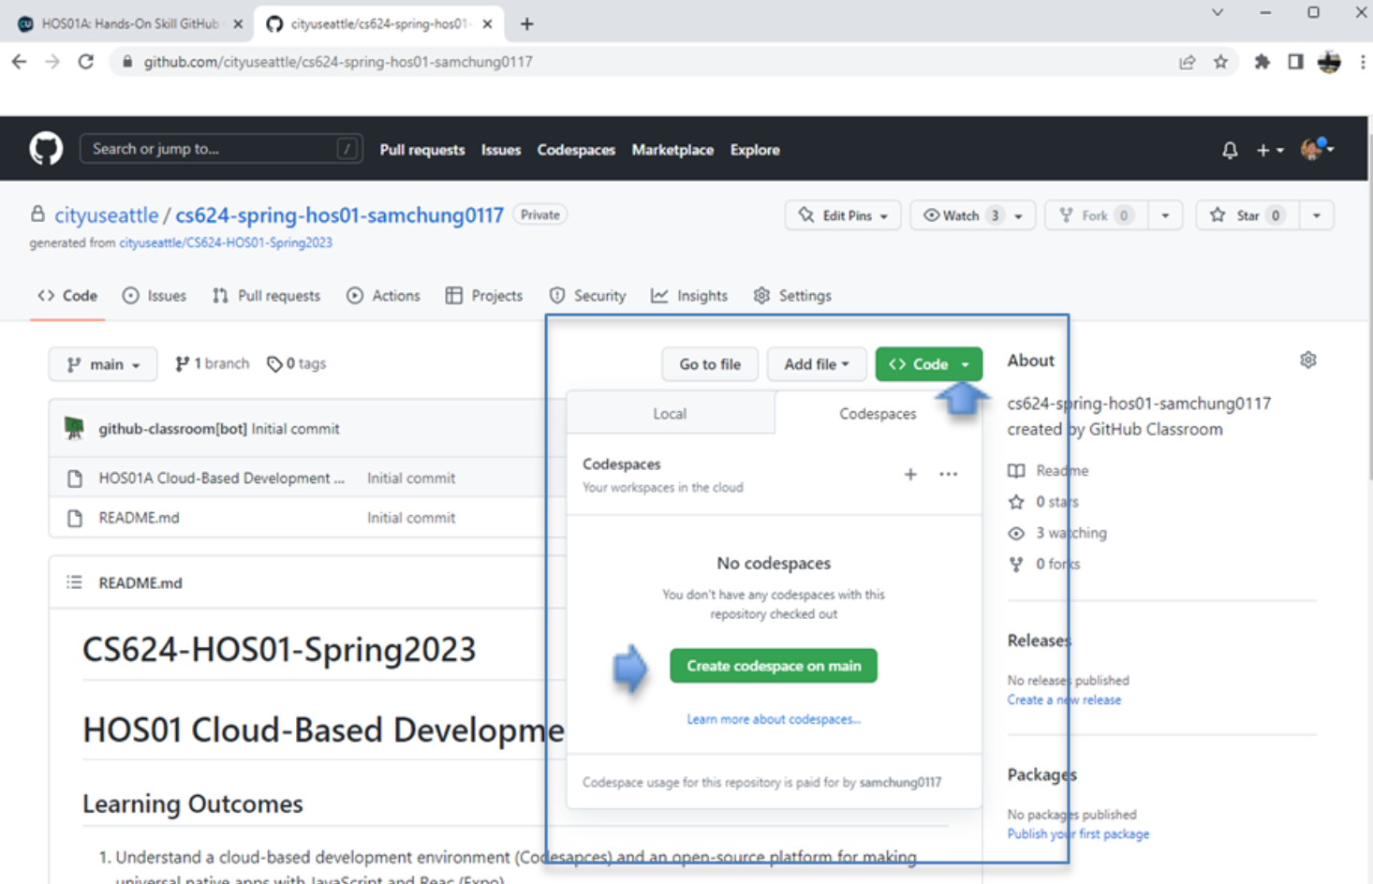
Accessing GitHub Codespaces

Slide 19
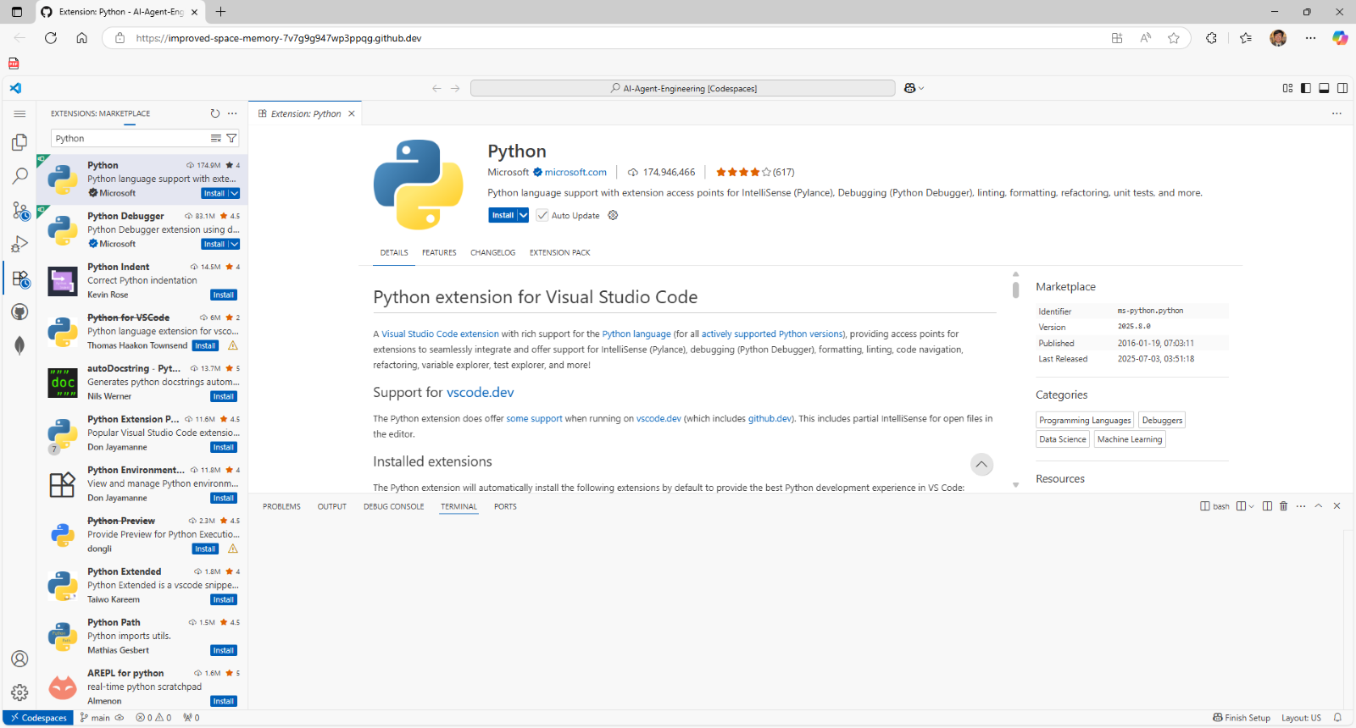
Installing Python Extension

Slide 20
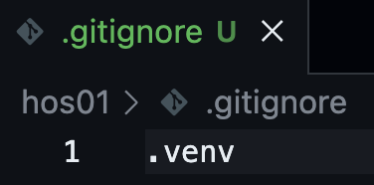
Creating .gitignore
echo .venv >> .gitignore
Appends that text to the end of the .gitignore file (creates it if it doesn't exist)

Slide 21
Setting up our virtual environment
>>> python -m venv .venv
python: Invokes the Python interpreter.
-m venv: Tells Python to run the venv module, which is used for creating virtual environments.
.venv: Specifies the name of the directory where the virtual environment will be created. The leading dot (.) often indicates that it's a hidden directory, but its visibility depends on your operating system's settings.

Slide 22
Activating our virtual environment
>>> source .venv/bin/activate
This command instructs the current terminal session to use the specific Python interpreter and packages associated with the virtual environment located at .venv.

Slide 23
Install our dependencies
>>> echo google-adk[database]==1.6.1 >> requirements.txt
google-adk: The main package for the Google Agent Development Kit.
[database]: This is an "extra" dependency. It tells pip to install not only the core google-adk package but also any additional packages required for its database integration features.
>>> pip install -r requirements.txt
pip reads the “requirements.txt” file and installs all the listed packages with the specified versions.

Slide 24
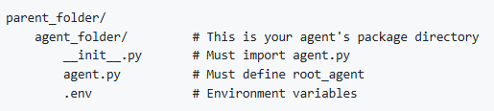
Creating the Agent project structure
>>> mkdir greeting_agent
>>> touch greeting_agent/__init__.py
>>> touch greeting_agent/agent.py
>>> touch greeting_agent/.env

Slide 25
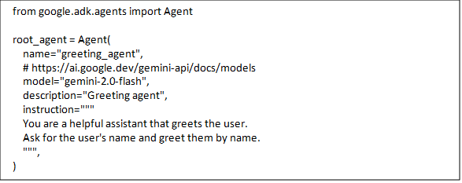
Writing the code/logic

Slide 26

Setting up an External LLM Service: Create a Project and API Keys in Google Cloud

Slide 27
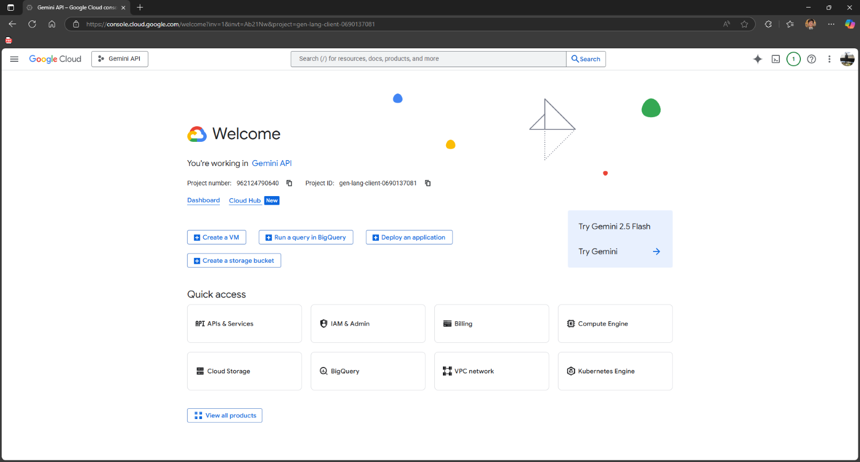
Setting up an External LLM Service: Create a Project and API Keys in Google Cloud

Slide 28
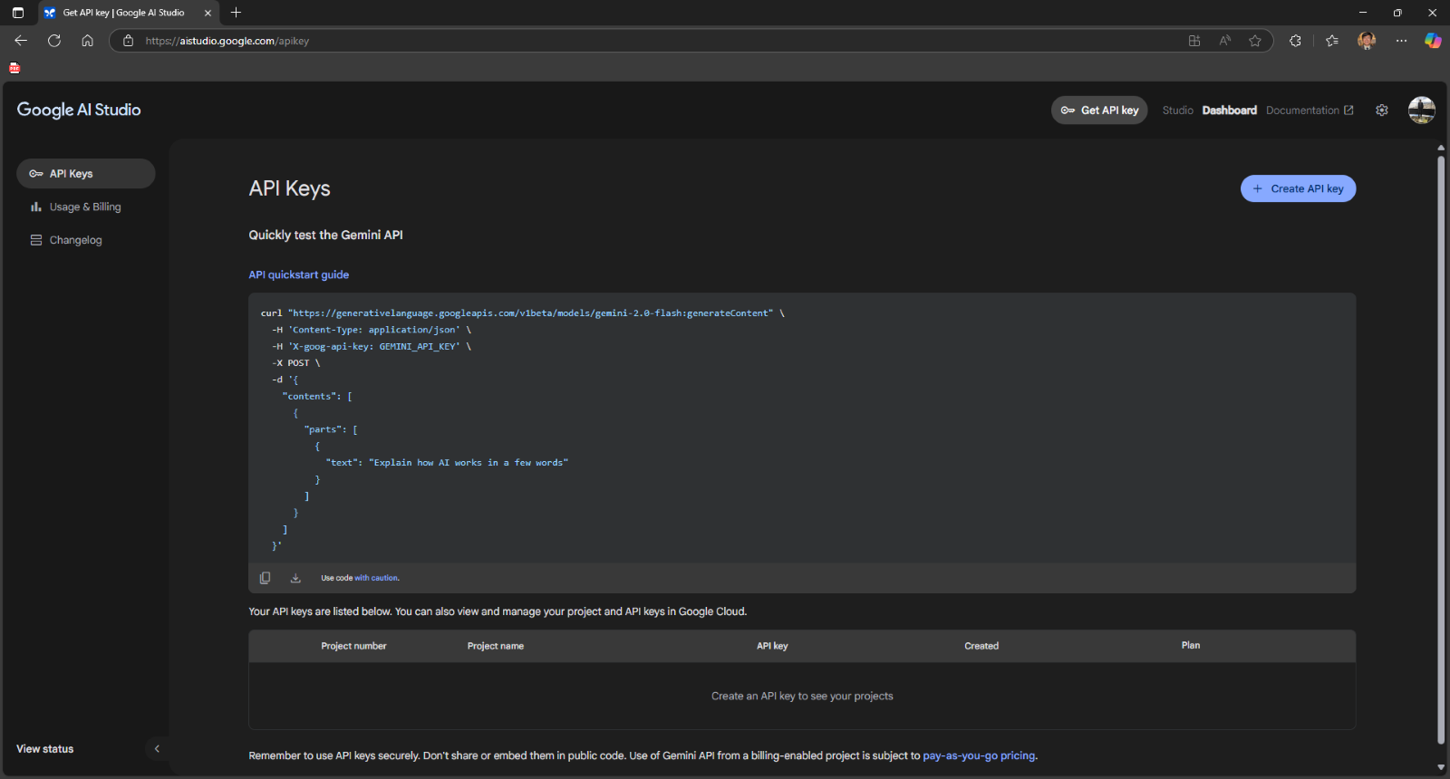
Setting up an External LLM Service: Create a Project and API Keys in Google Cloud

Slide 29
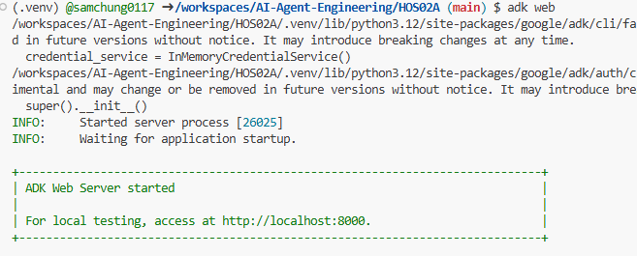
Running your Agent with adk web
>>> adk web

Slide 30
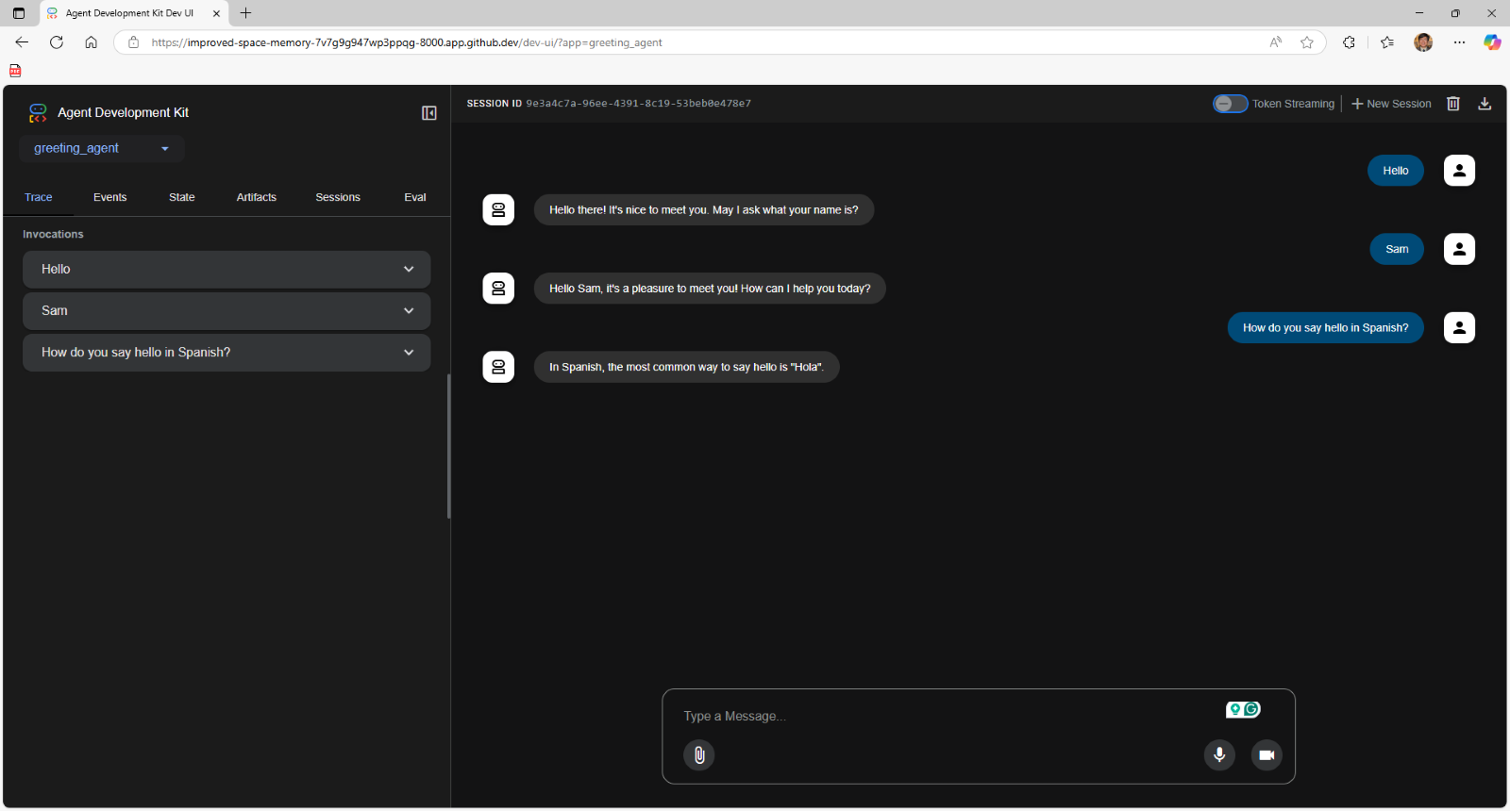
Interacting with your Agent

Slide 31
References
Dmitrievna‌, Y., & Parsadanyan, E. (2025, February 10). AI Agents Explained: From Theory to Practical Deployment. N8n Blog. https://blog.n8n.io/ai-agents/
LangChain. (2024). LangChain State of AI Agents Report. Langchain.com. https://www.langchain.com/stateofaiagents
‌Russell, S., & Norvig, P. (2022). Artificial Intelligence: A Modern Approach, 4th US ed. Berkeley.edu. https://aima.cs.berkeley.edu/
Google Agent Development Kit (ADK)
google-adk·PyPI
Gemini models | Gemini API | Google AI for Developers
Brandon Hancock's ADK Crash Course
Module 1: Basic Agent
Brandon Hancock's ADK Masterclass: Build AI Agents & Automate Workflows (Beginner to Pro) (3:12:47)
Module 1: Basic Agent (0:04:20 – 0:23:00)
Notes:
In this module 01A, we discussed the following topics:
If you have any questions, feel free to contact me.
Thank you

Slide 32

Q&A
Notes:
In this module 01A, we discussed the following topics:
If you have any questions, feel free to contact me.
Thank you

